Slide 1
Vending Machine Controller
By Marina Abdalkarim and Matt Alecci

Slide 2
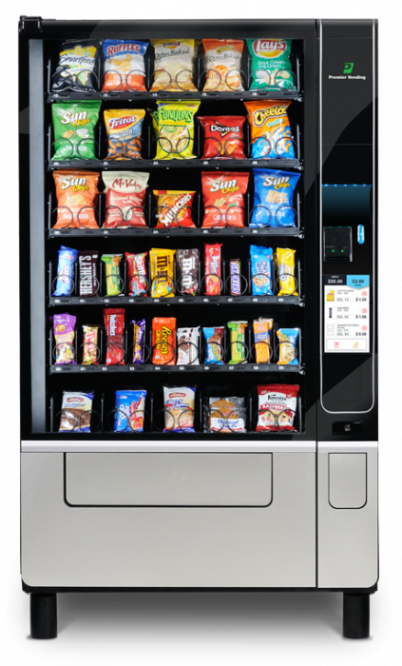
Introduction
Select the snack you desire (chocolate or chips)
Insert currency for item price (quarters or dollar)
Retrieve item and (possibly) change

Slide 3
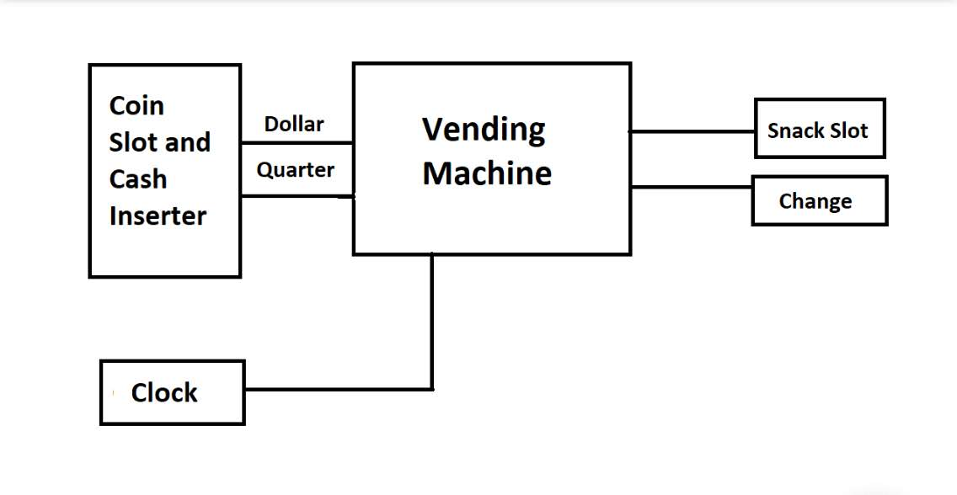
Block Diagram

Slide 4
Specification (Coin Slot)
Select between Quarter1, Quarter2, Quarter3 and Dollar
Quarters are labelled as X, Dollar as Y
Chips costs 75¢, either switch on three of the quarters or just the dollar
Chocolate costs $1.00, just switch on the dollar.

Slide 5
Specification (Vending Machine)
2 D flip flops: A and B
3 inputs: X(quarters), Y(dollar), and C(chocolate/chips).
3 Outputs: W(chips), T(chocolate), and Z(change)
Decide between chips and chocolate, switch to “1” for chips, “0” for chocolate.

Slide 6
Specification (Change/Snack)
If you selected chips, three quarters results in a “1” in the chips output and “0 “ in change
A dollar results in a “1” in the chips output as well as a “1” in change for 1 quarter returned
If you selected chocolate, three quarters results in all “0” since it’s not the price
A dollar results in a “1” in the chocolate output and a “0” in change

Slide 7
Comparison
Displays Change
Has choice of item
Reasonable input options at realistic prices.
As a real vending machine would, only allows you to choose one item at a time.

Slide 8
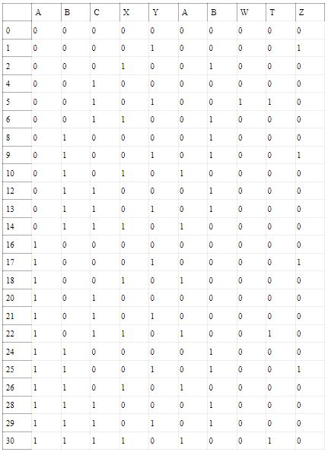
State Table
Present State Input Next State Output

Slide 9
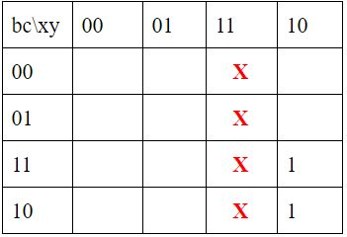
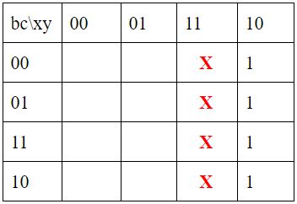
K-Maps
A’
A
Da = BX + AX

Slide 10
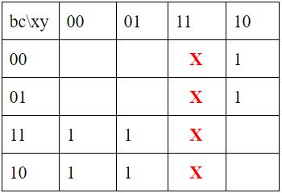
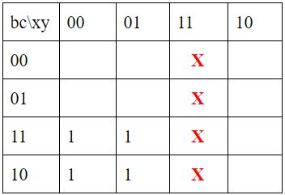
A’
A
Db = BX’ + A’B’X

Slide 11
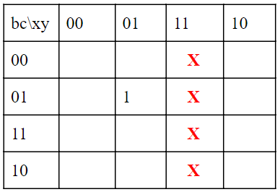
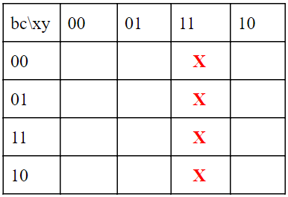
A’
A
Z = A’B’CY

Slide 12
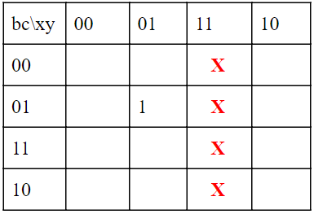
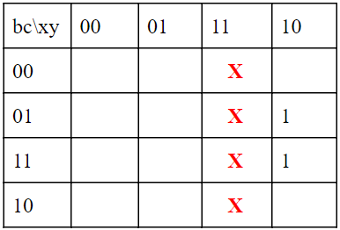
A’
A
W = A’B’CY

Slide 13
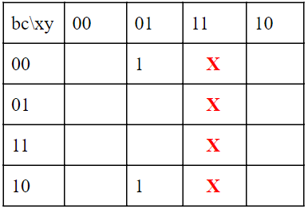
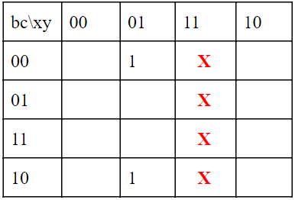
A’
A
T = YC’

Slide 14
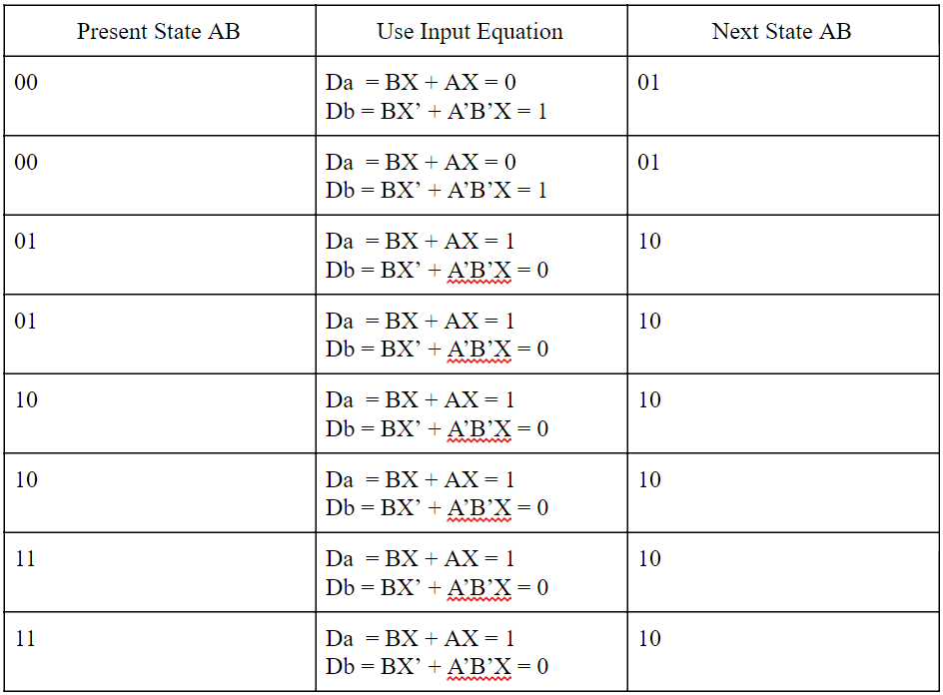
Verification

Slide 15
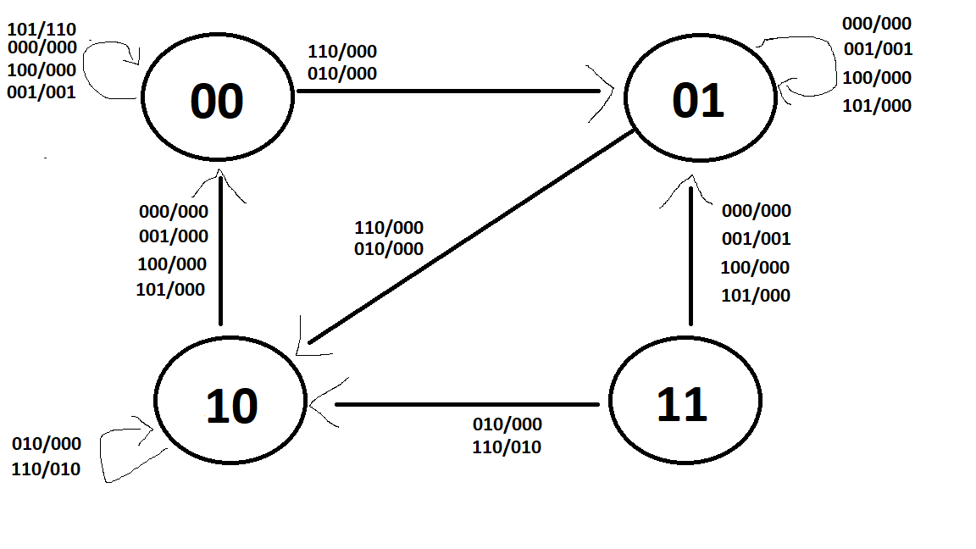
State Diagram

Slide 16
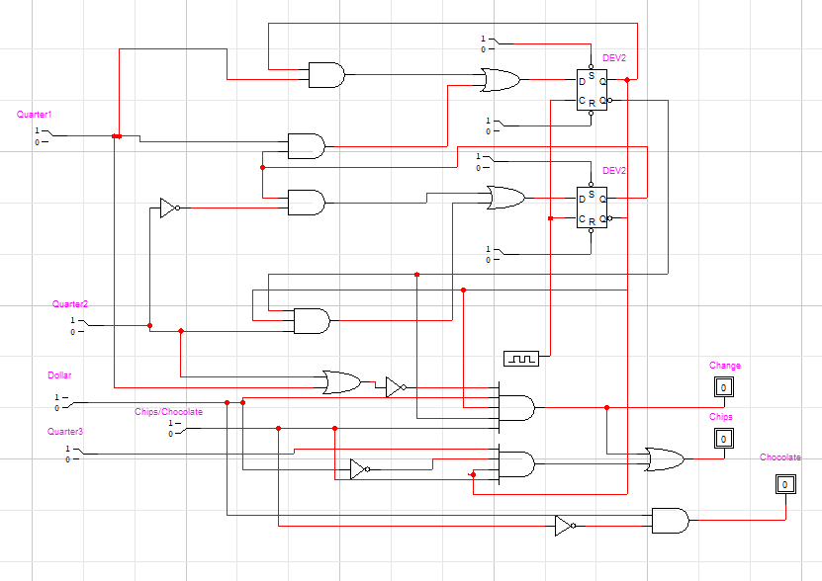
Circuit

